Slide 1


What do they have in common?
PLUS FILE

Slide 2
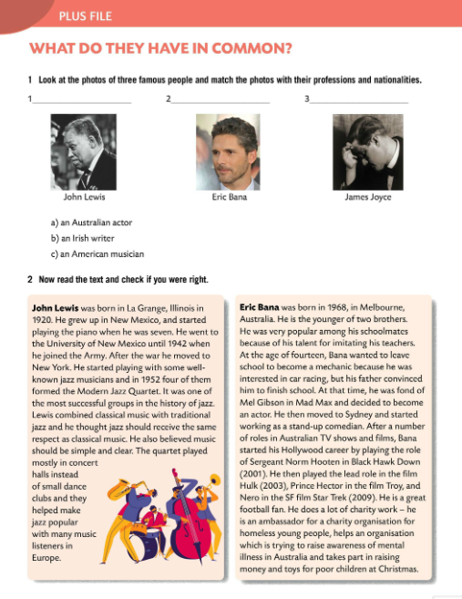
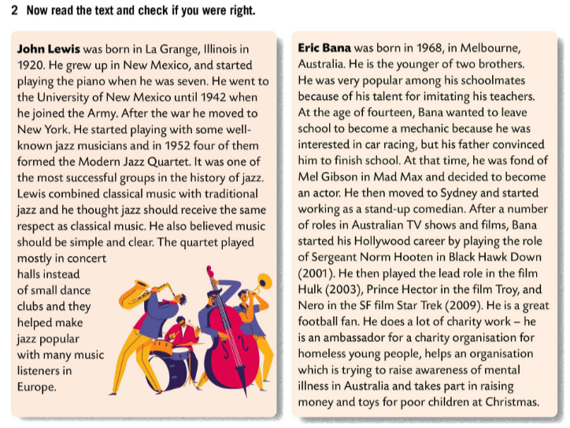
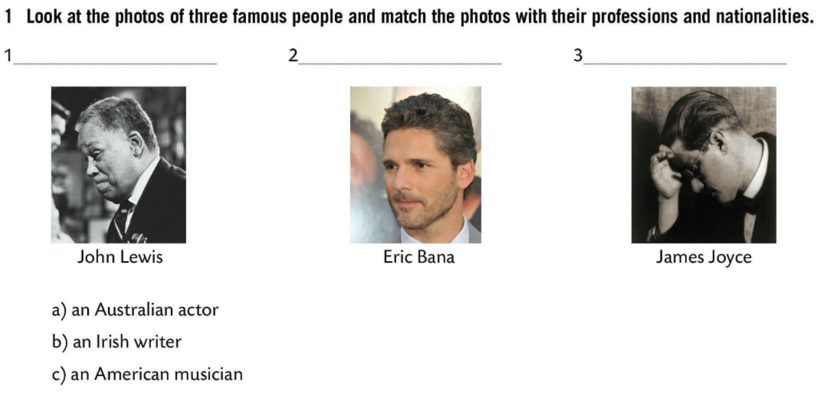
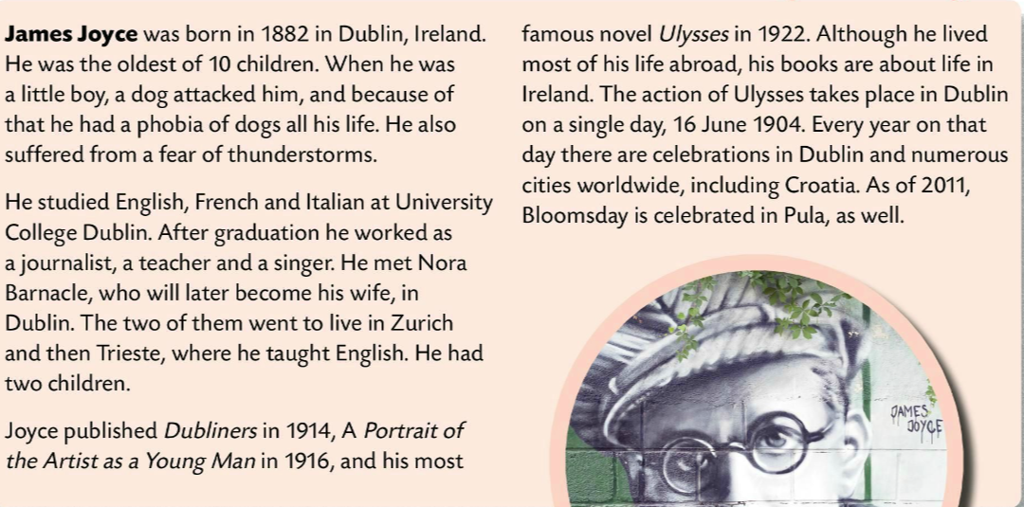
Look at the photos of three famous people and match the photos with their professions and nationalities.
c) an American musician
a) an Australian actor
b) an Irish writer
Check.
Now read the text.

Slide 3
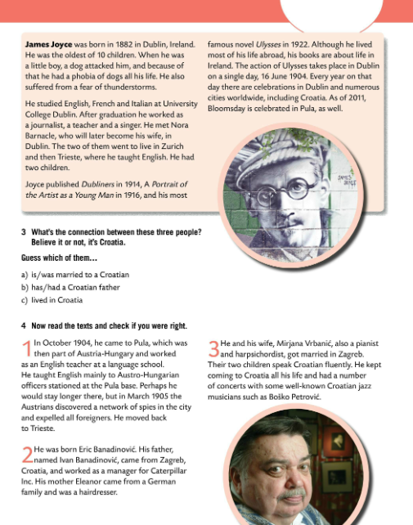
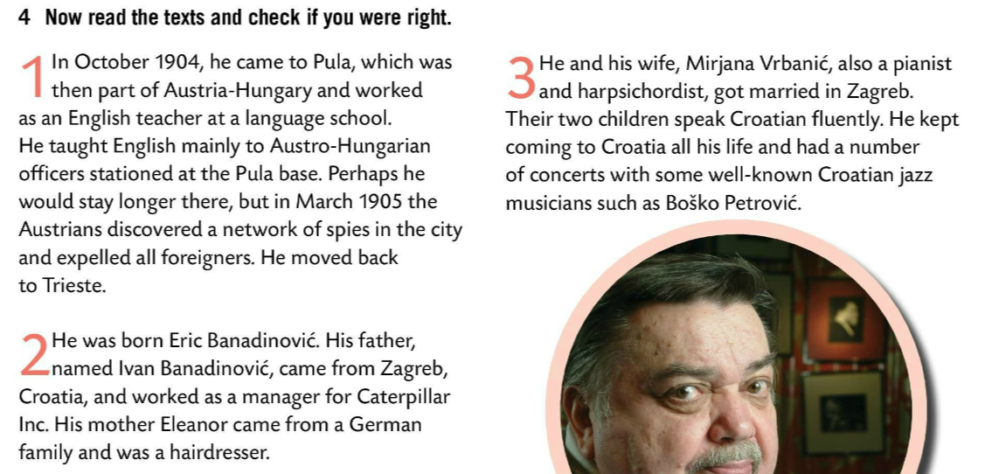
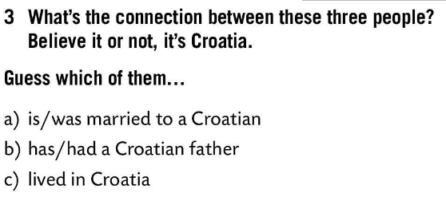
What’s the connection between these three people?
Believe it or not, it’s Croatia.
Guess which of them….
J.Lewis was married to a Croatian.
Now read the text and check if you were right.
Eric Bana has a Croatian father.
James Joyce lived in Croatia.

Slide 4
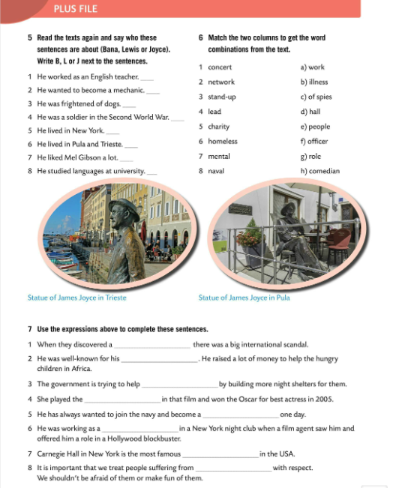
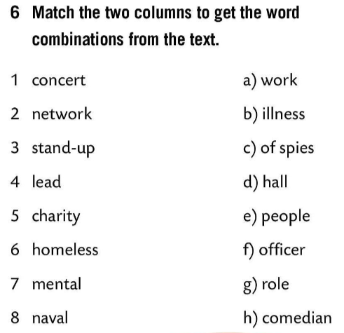
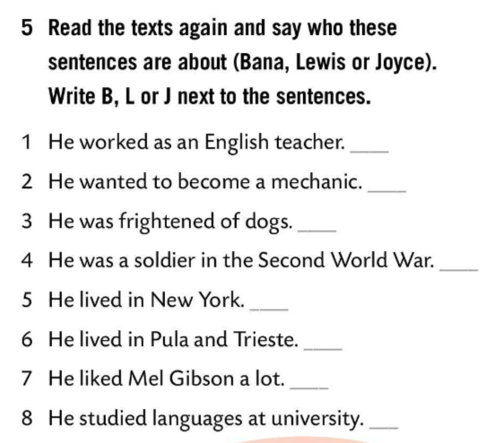
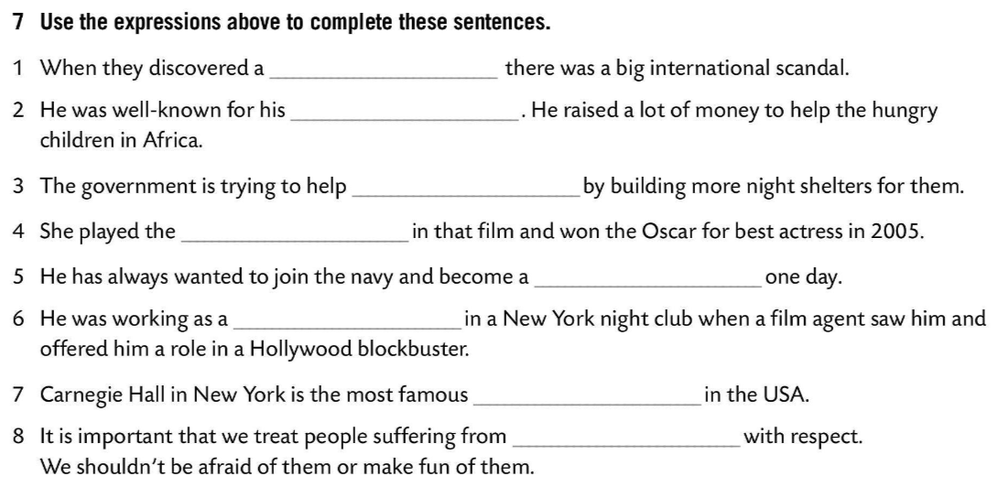
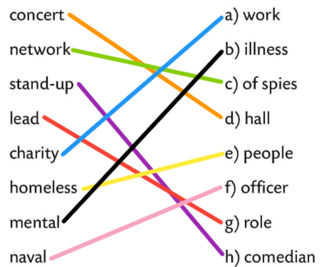
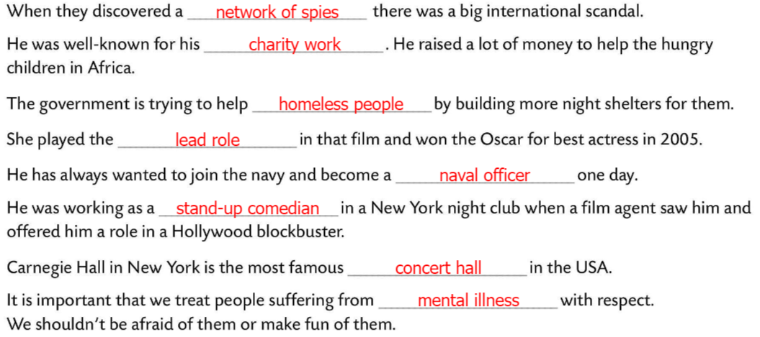
Read the texts again and say who these sentences are about (Bana, Lewis or Joyce). Write B, L or J next to the sentences.
Check.
J
B
Match the two columns to get the word combinations from the text.
J
L
L
Check.
J
B
Use the expression above to complete these sentences.
J
Check.

